Slide 1


Docling Get your documents ready for gen AI
IBM Research
–
Ming Zhao
Software developer, Open Tech
mingzhao@IBM.com
https://www.linkedin.com/in/mingxuan-z-9a5a6419a/

Slide 2
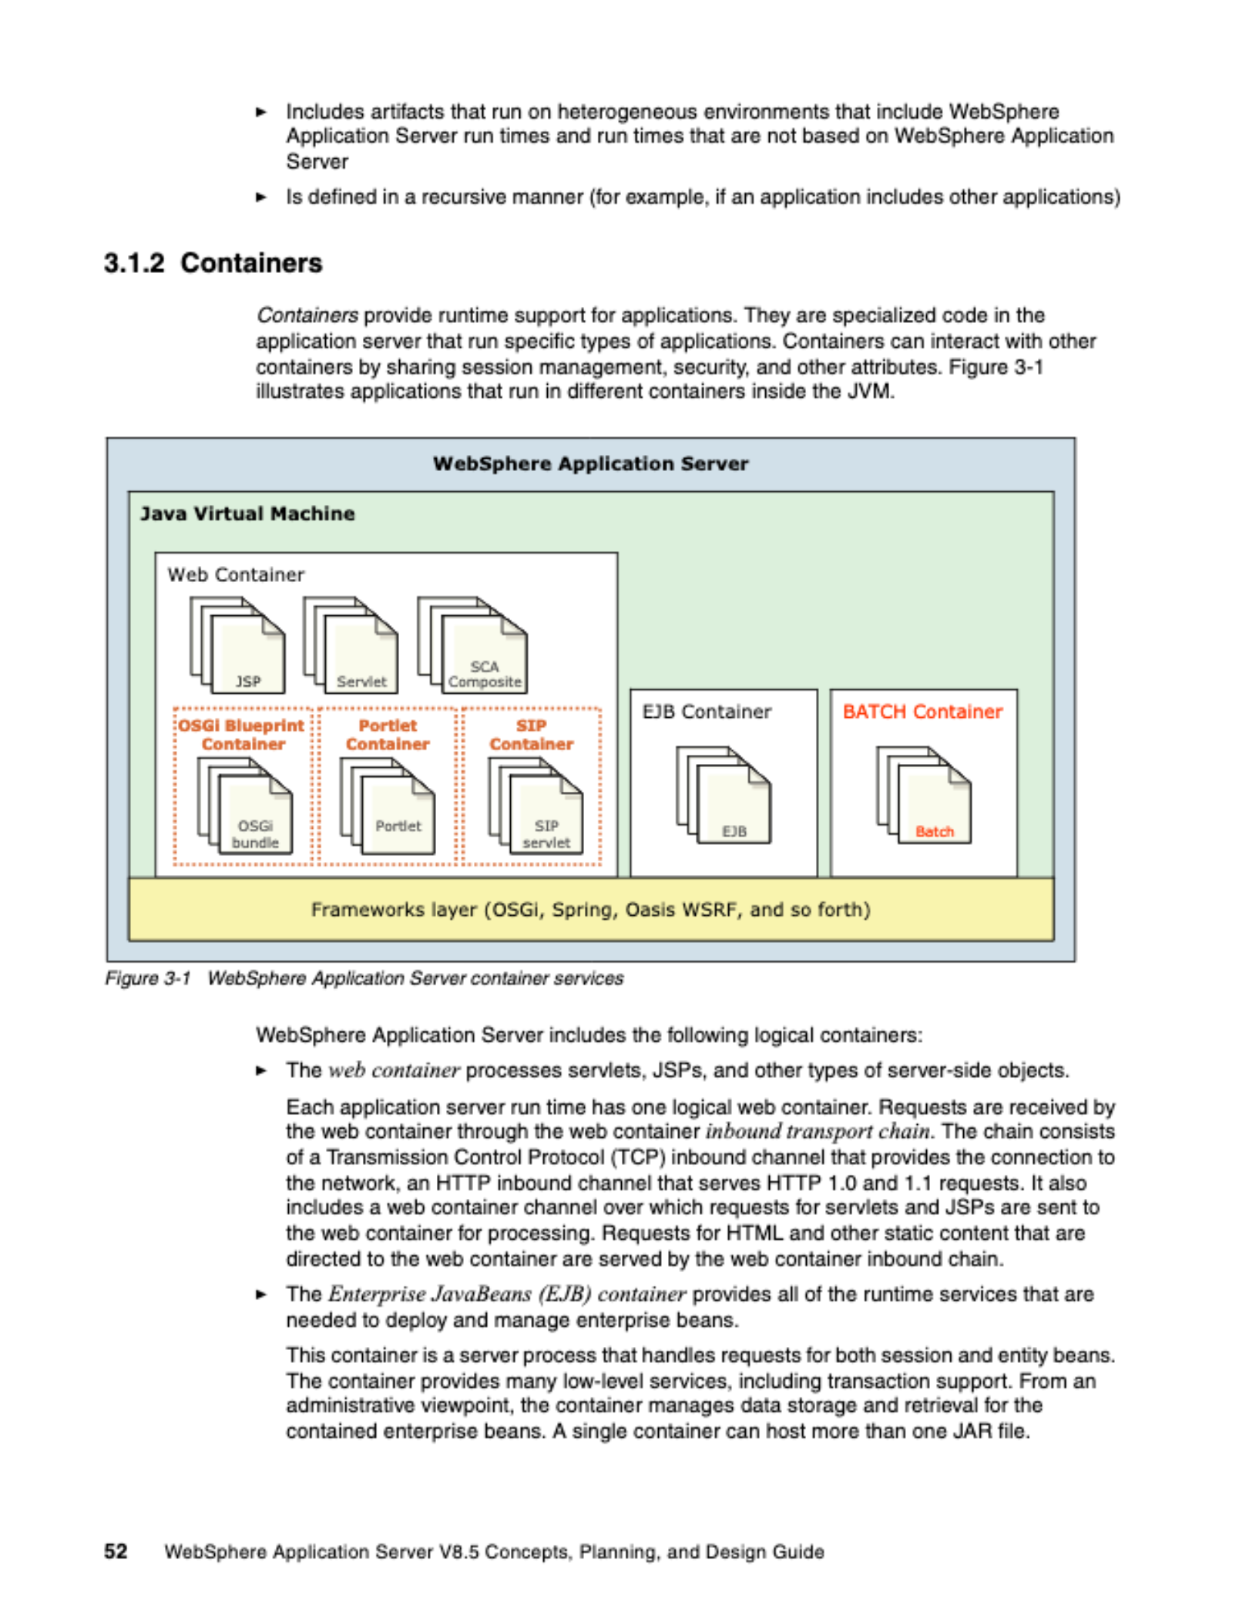
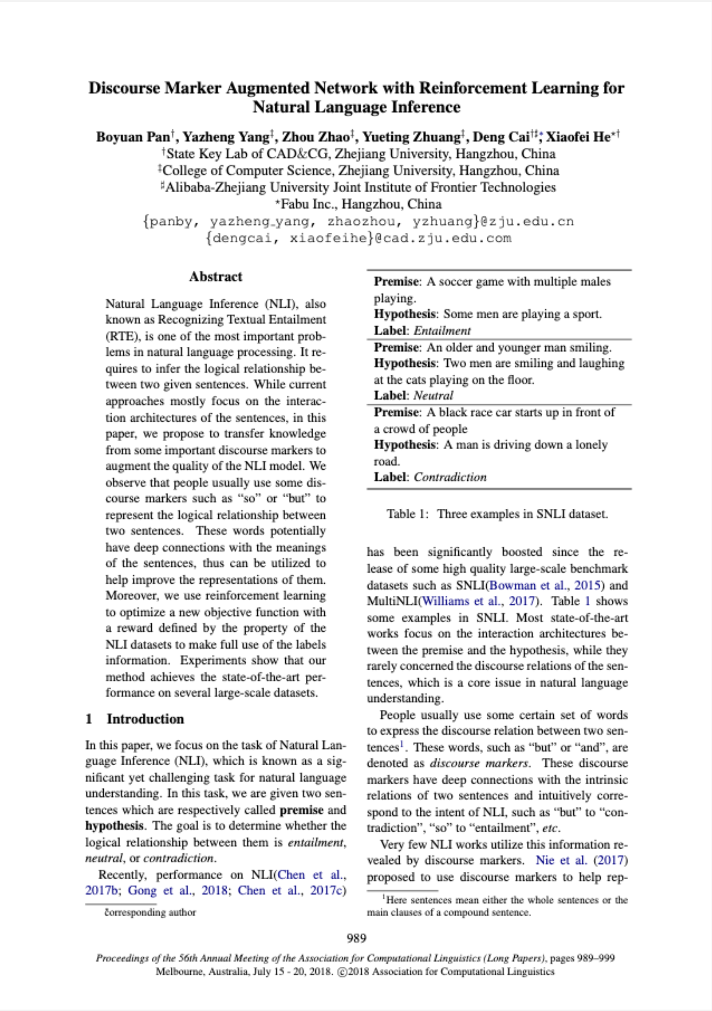
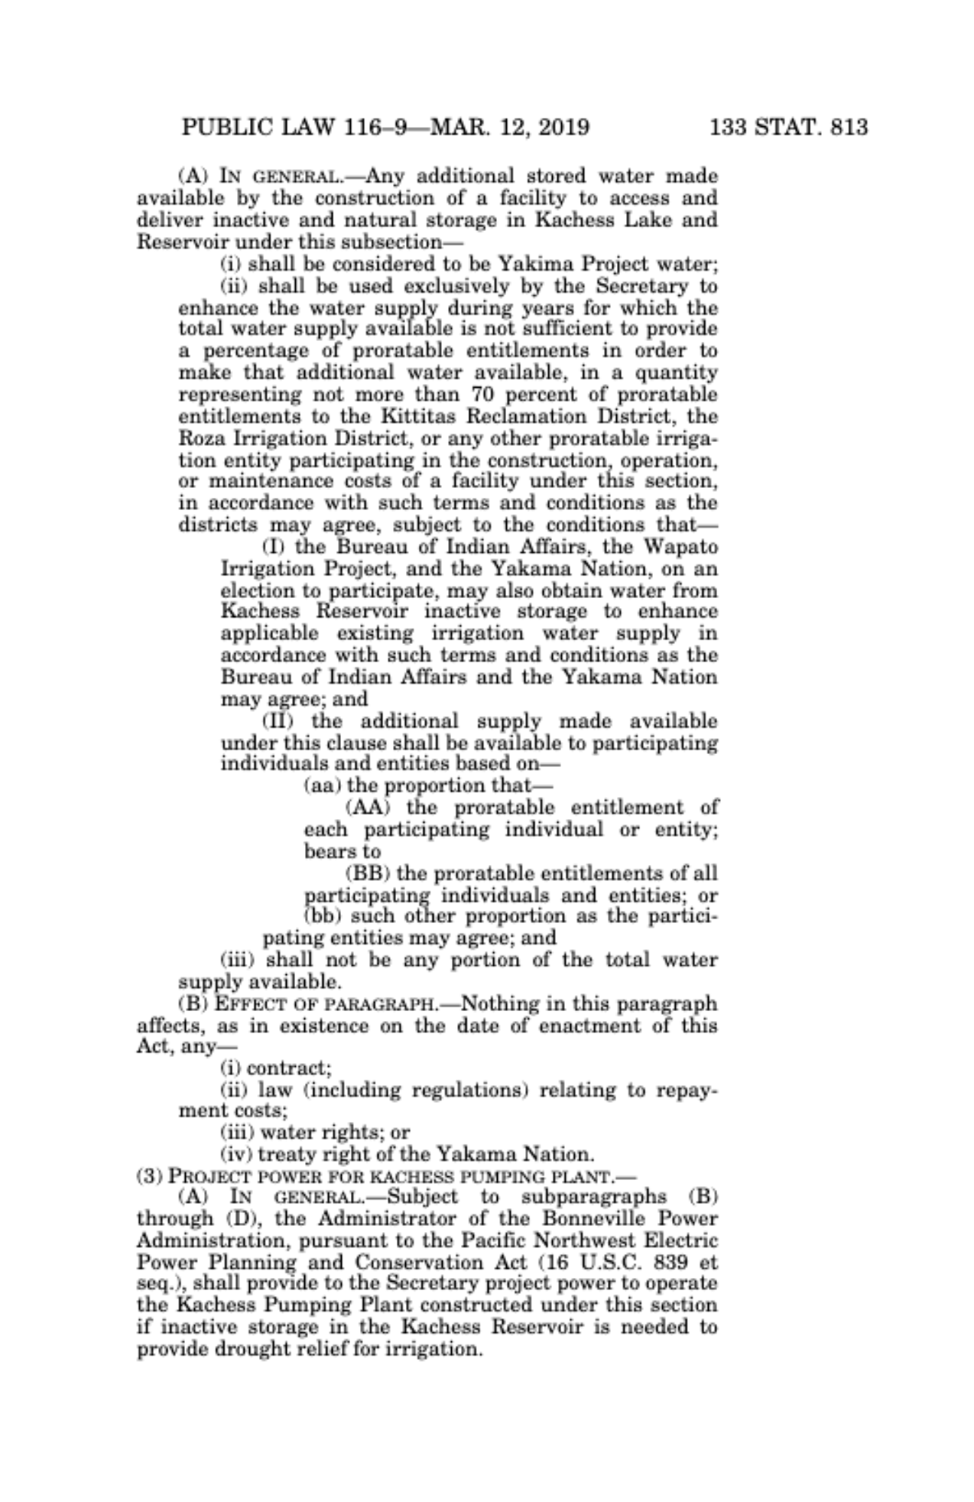
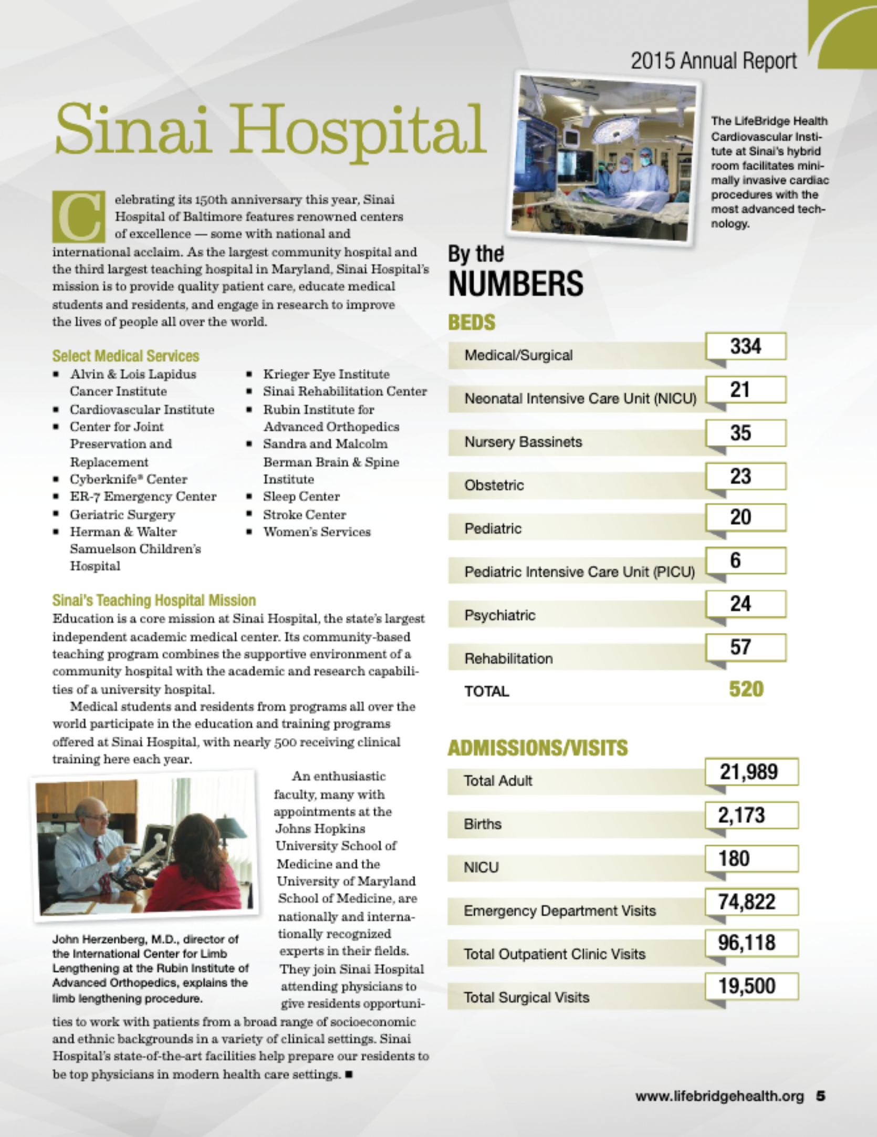
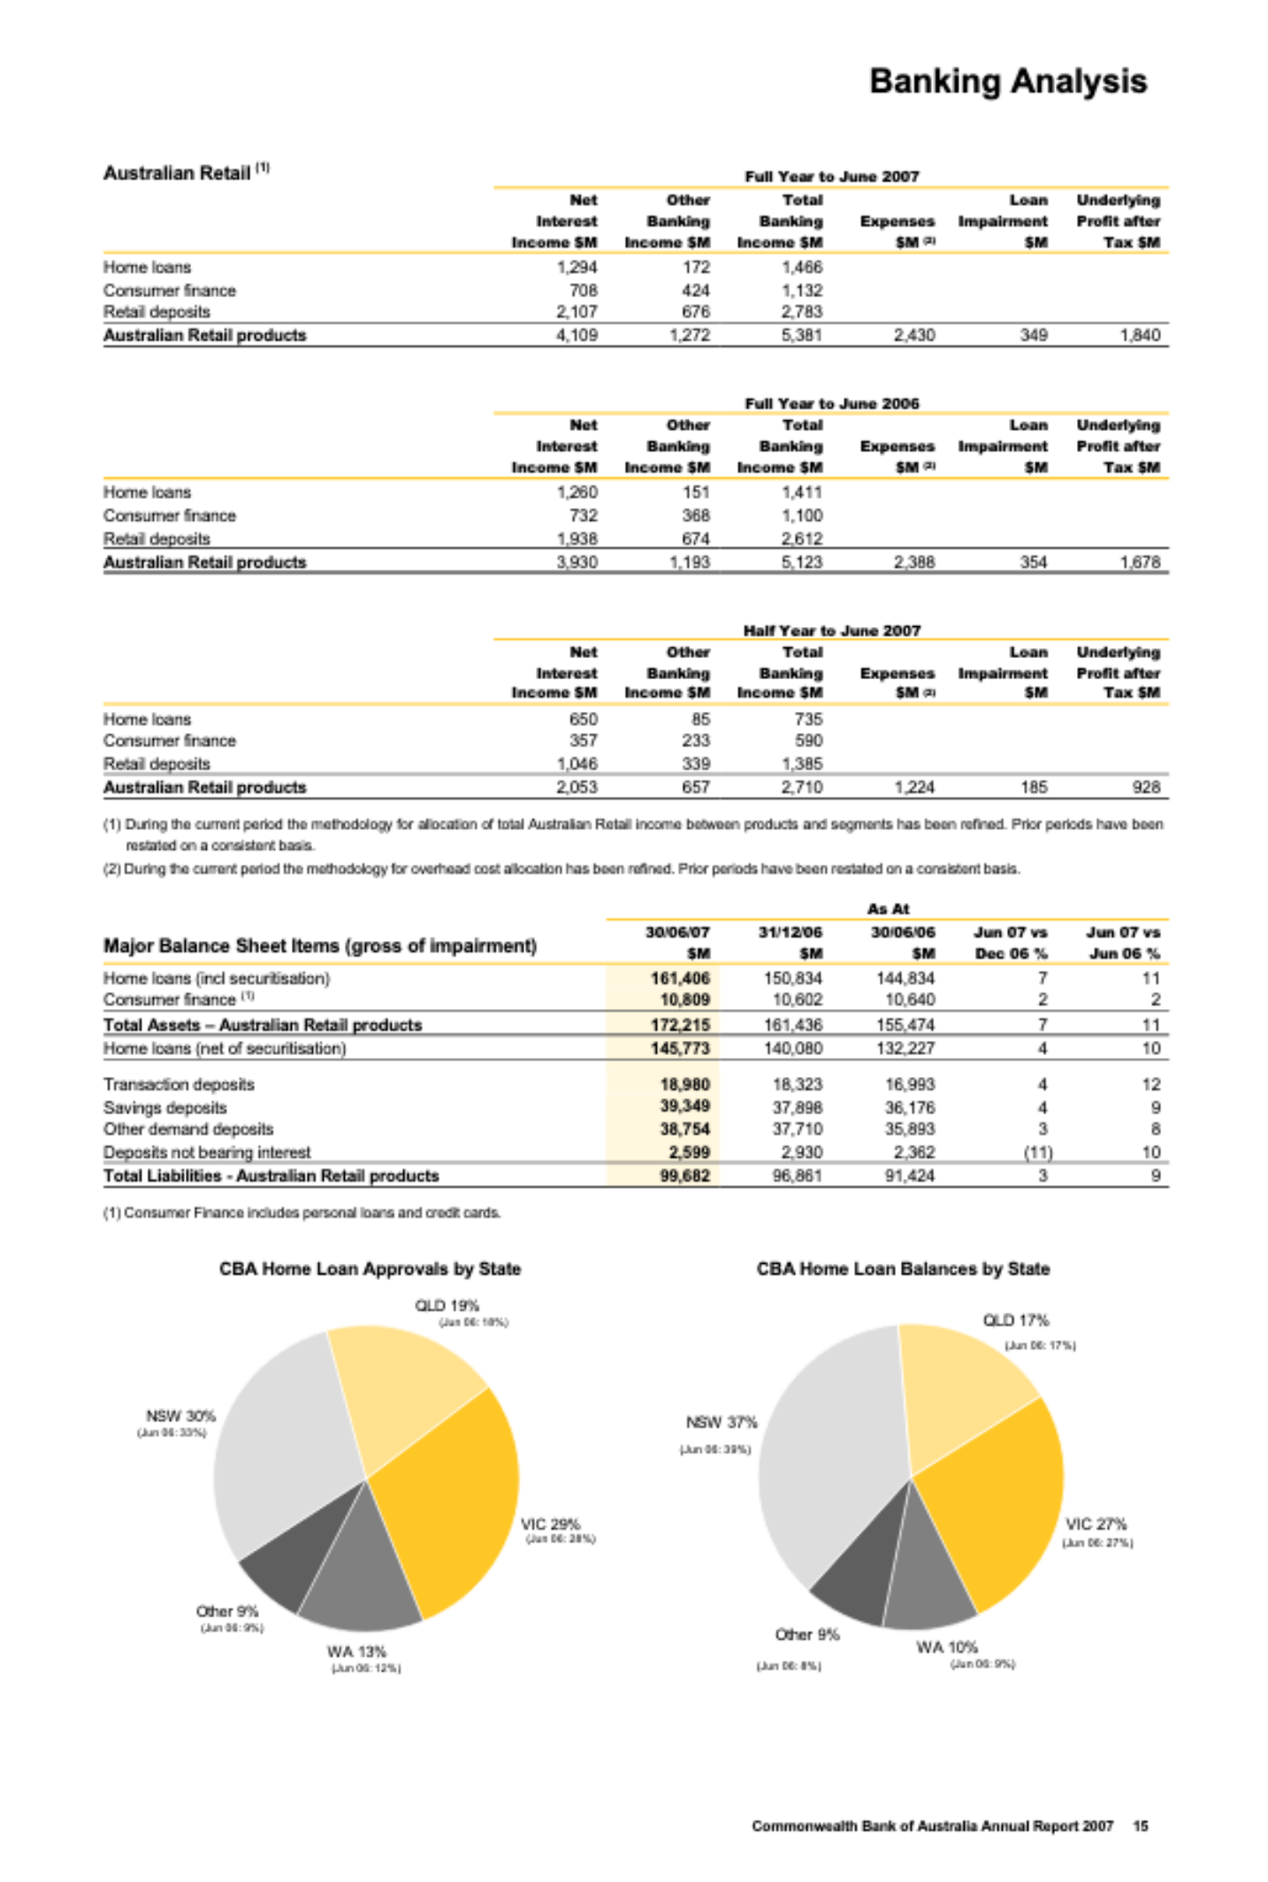
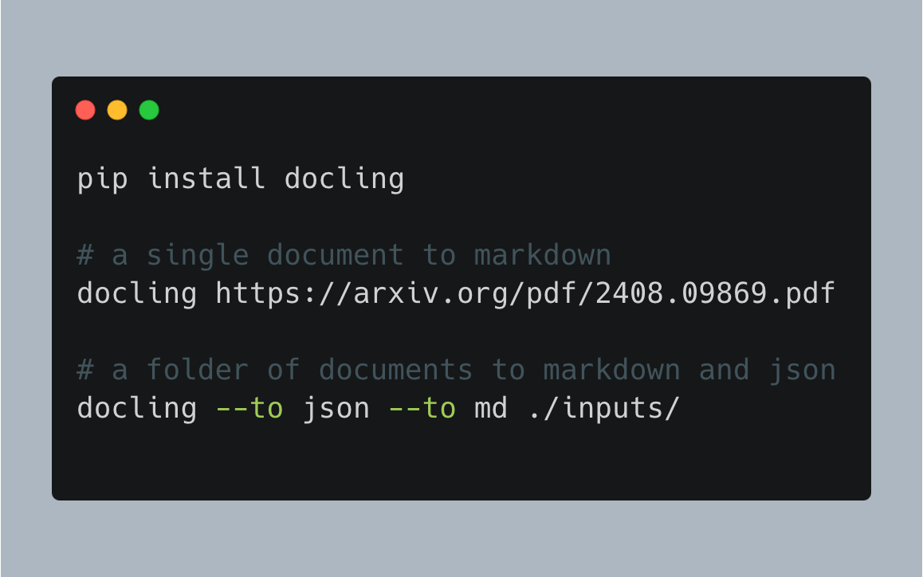

Introducing Docling
🗂️ Parsing of multiple document formats incl. PDF, DOCX, XLSX, HTML, images, and more
📑 Advanced PDF understanding incl. page layout, reading order, table structure, code, formulas, image classification, …
🧬 Unified, expressive DoclingDocument representation format
↪️ Various export formats (Markdown, HTML, JSON)
🔒 Local execution for sensitive data and air-gapped environments
🤖 Many plug-and-play ecosystem integrations
🔍 Extensive OCR support for scanned PDFs and images
🥚 Support of Visual Language Models
💻 Simple and convenient CLI

Slide 3
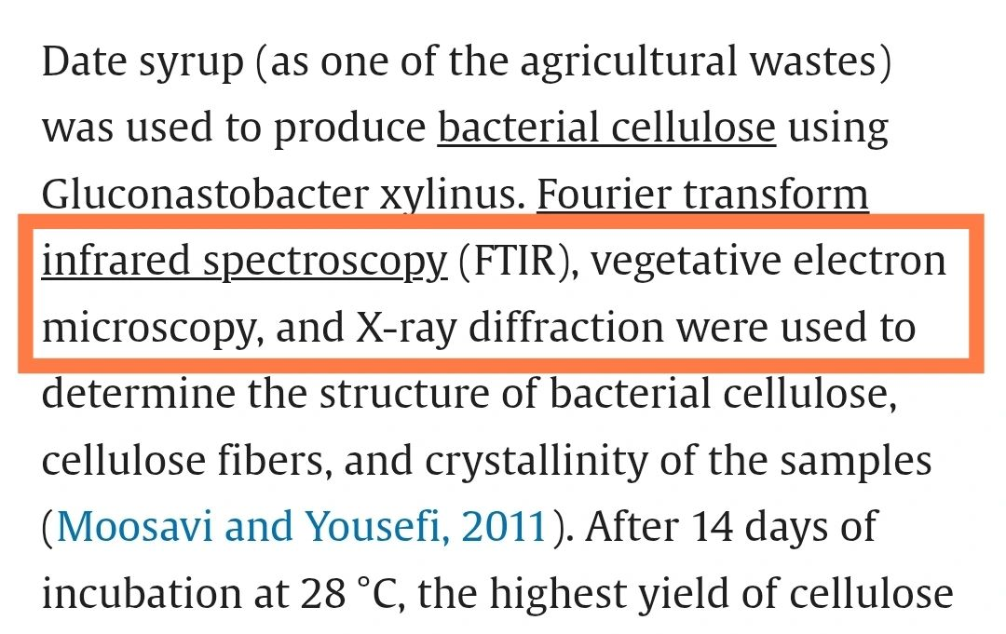
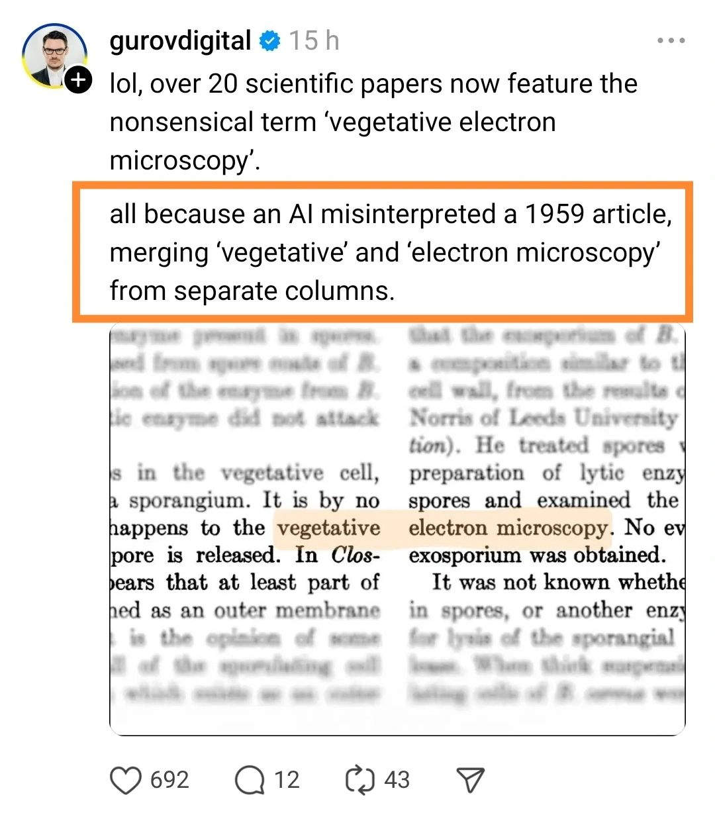
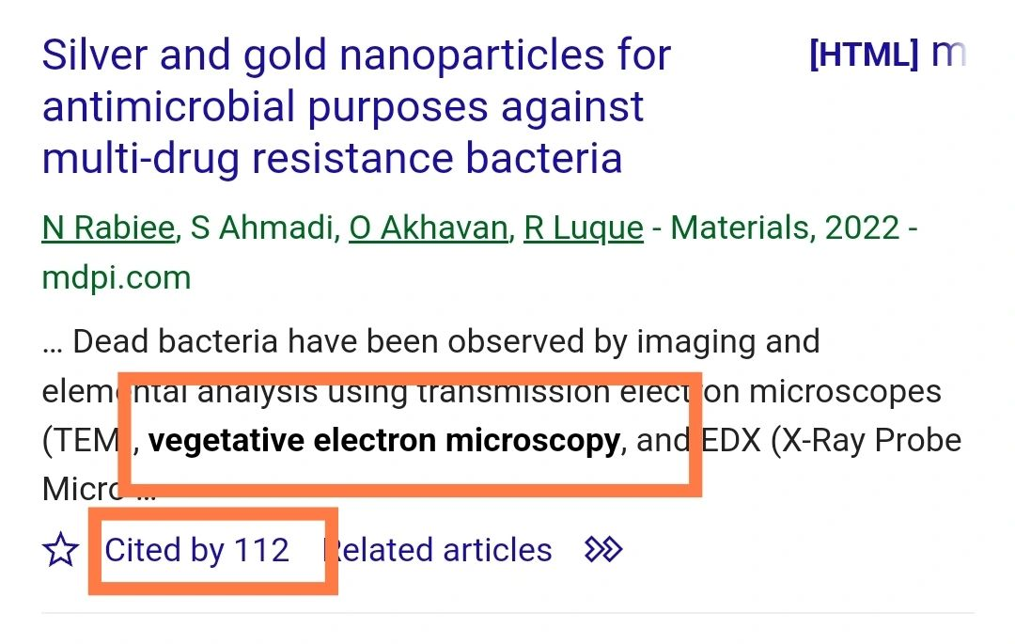
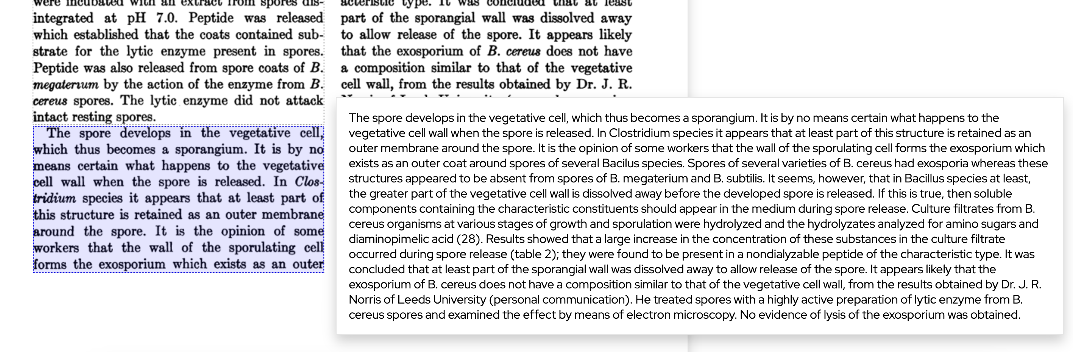
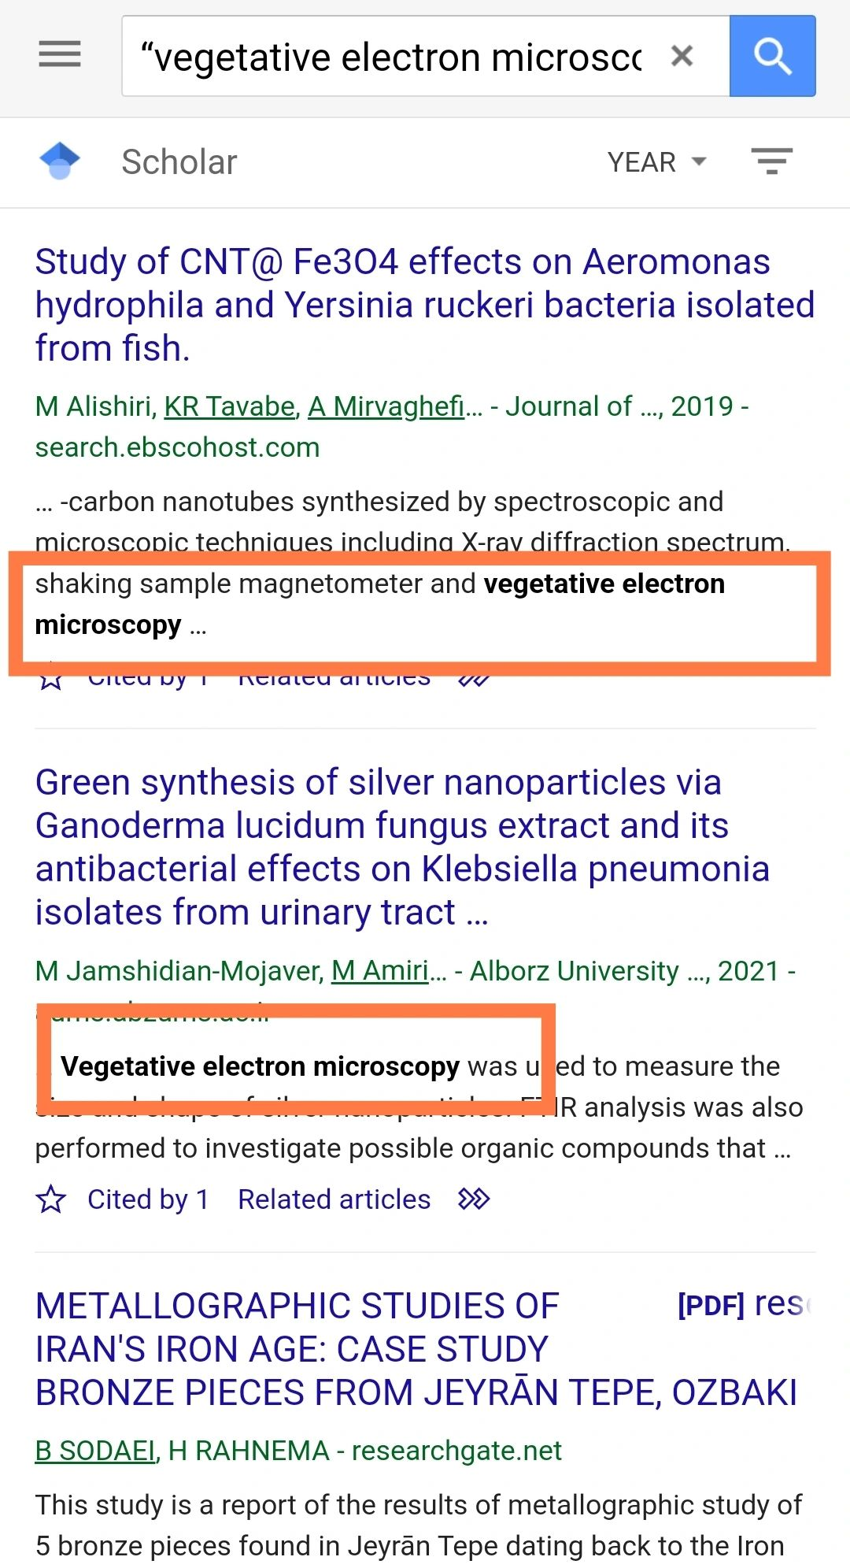
Without Docling…
…it can go bad.

Slide 4
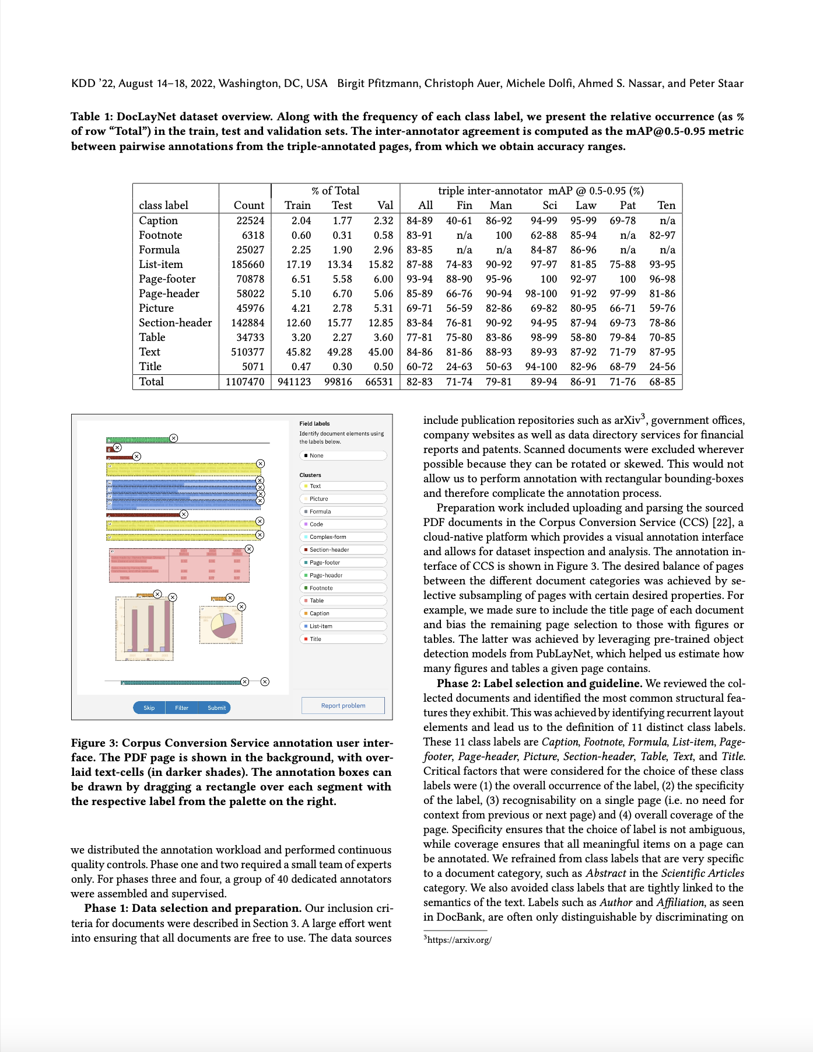



Recovering structured content from PDF
with low-level PDF parsers
!
undesired
page headers
KDD ’22, August 14–18, 2022, Washington, DC, USA Birgit Pfitzmann, Christoph Auer, Michele Dolfi, Ahmed S. Nassar, and Peter Staar
Table 1: DocLayNet dataset overview. Along with the frequency of each class label, we present the relative occurrence (as %
of row “Total”) in the train, test and validation sets. The inter-annotator agreement is computed as the mAP@0.5-0.95 metric
between pairwise annotations from the triple-annotated pages, from which we obtain accuracy ranges.
% of Total
triple inter-annotator mAP @ 0.5-0.95 (%)
[…]
Count
22524
6318
25027
185660
70878
58022
45976
142884
34733
510377
5071
1107470
[…]
include publication repositories such as arXiv3, government o"ces,
company websites as well as data directory services for #nancial
reports and patents. Scanned documents were excluded wherever
possible because they can be rotated or skewed. This would not
allow us to perform annotation with rectangular bounding-boxes
and therefore complicate the annotation process.
[…]
Very fast and cheap
Incomplete
Loss of structure
Noisy
Unfit for most use cases
!
Tables not understood
!
Image content missing
!
Line wraps not understood
!
Multi-column often breaks order
Notes:
Where does that put docling in the space of available solutions?
At one end of the spectrum, we have basic PDF parsing libraries
Pdfium
PDFMiner
pypdfium

Slide 5
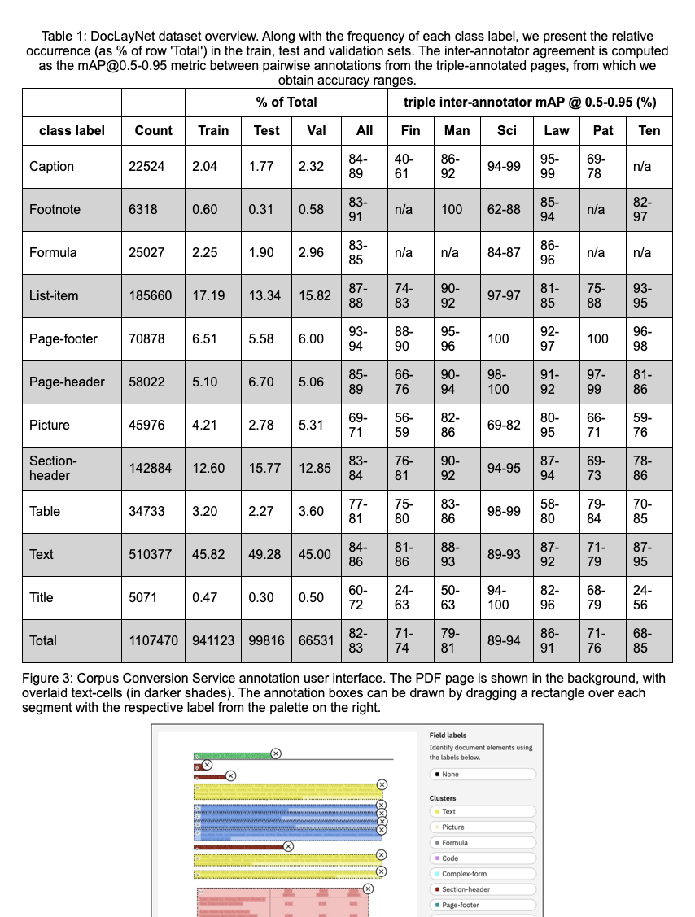
Recovering structured content from PDF
with Docling
Good quality
Fast and cheap
Fully local operation
Structured format output
Cost-effective at scale, with consistent representation and high quality
*results rendered as HTML for visualization purposes
Notes:
Docling is adopting the best traits from both ends

Slide 6



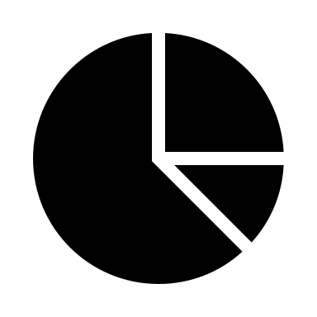

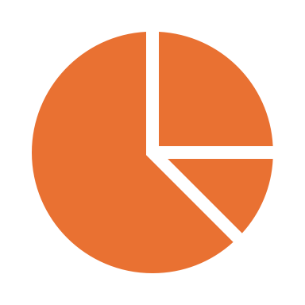





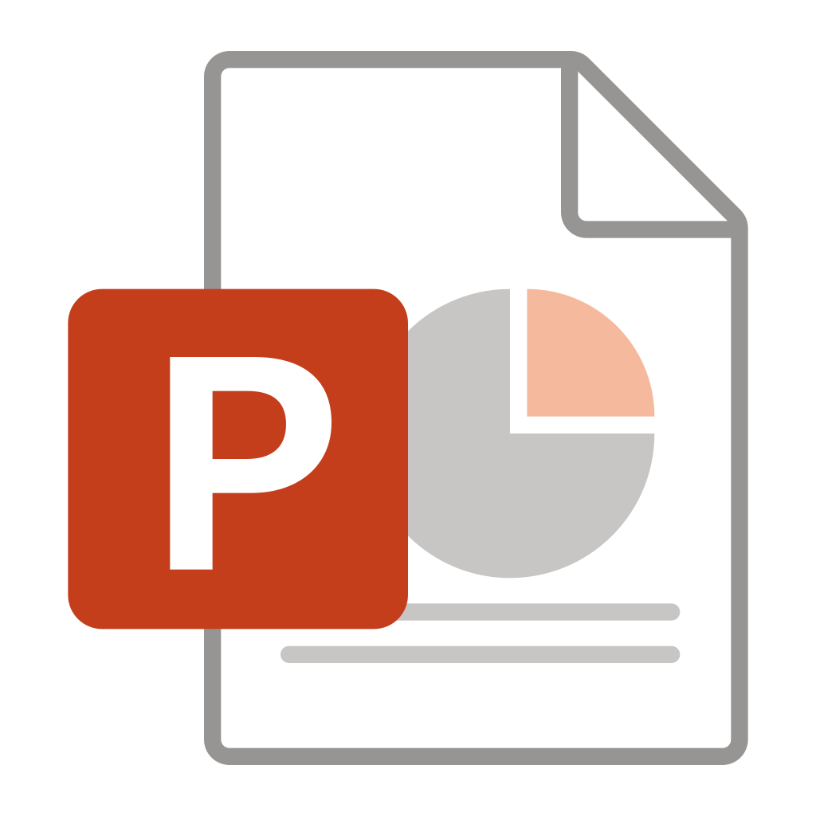
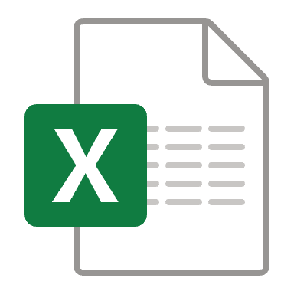

Design and Architecture
VLM Pipeline
Assemble Document
Page images
Build
PDF Pipeline
##
{;}
pdf
Export JSON,
Markdown,
HTML,
Figures,
…
Parse PDF pages
OCR
Layout
Analysis
Table Structure
Assemble Document
images
Build
Docling Document
Simple Pipeline
Create datasets
</>
ascii
md
html
AsciiDoc
Parse Markup Format
Assemble Document
Chunking
for RAG
docx
pptx
xlsx
…
Build
Enrich
Use

Slide 7
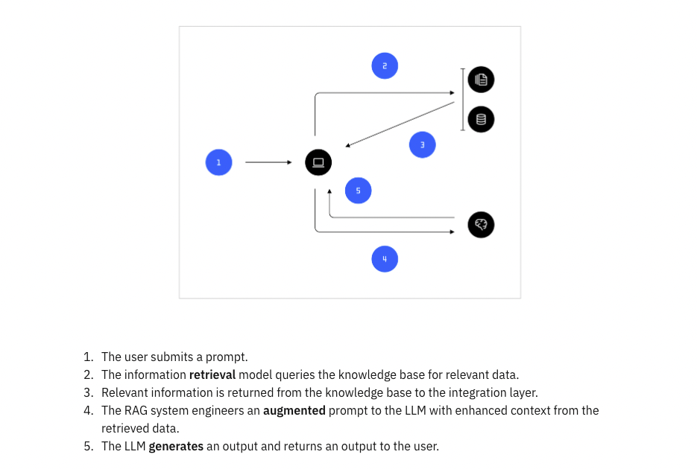
Retrieval Augmented Generation (RAG)

Slide 8
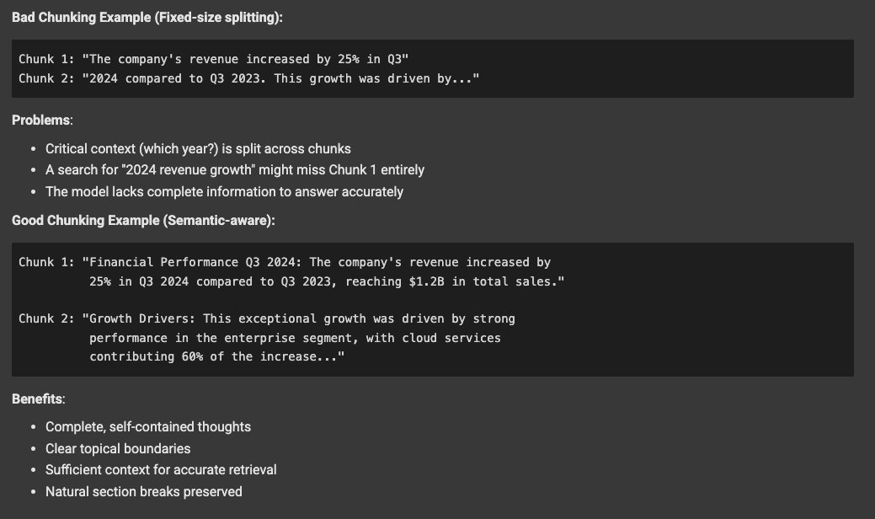

Slide 9
Multimodal RAG
Traditional RAG is limited to text-based use cases such as text summarization and chatbots.
Traditional RAG systems only handle text. But real documents contain:
Text: Paragraphs, lists, headers
Tables: Structured data, financial information
Images: Charts, diagrams, photos, illustrations
Multimodal RAG can use multimodal LLMs (MLLM) to process information
from multiple types of data to be included as part of the external knowledge base used in RAG.
Multimodal data can include text, images, audio, video or other forms.

